Slide 1

InvestorHub
Internship Hiring Task
Engagement Metrics • Hub UX • Internal Update
Data-driven engagement diagnosis, prioritized UX recommendations (case study)
SRUTHI RAJESH

Slide 2
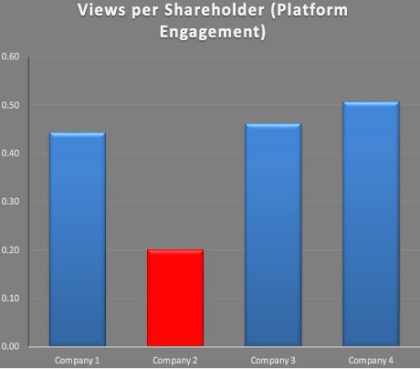

Activity 1
InvestorHub engagement happens through two channels: Email (open rate) and platform usage (InvestorHub views).
Because companies have different shareholder counts, we use normalized metrics to compare fairly.
Views per Shareholder = Views / Active Shareholders Estimated Email Opens = Active Shareholders × Open Rate
Company | Active Shareholders | InvestorHub Views | Email Open Rate | Views per Shareholder | Estimated Email Opens
Company 1 | 4200 | 1860 | 42% | 0.44 | 1764
Company 2 | 1050 | 210 | 18% | 0.20 | 189
Company 3 | 2600 | 1200 | 38% | 0.46 | 988
Company 4 | 6800 | 3450 | 55% | 0.51 | 3740
Finding: Company 2 Group is the least engaged company: lowest email engagement and lowest platform usage per shareholder.
Platform usage: 0.20 views/shareholder (peers: 0.44–0.51) indicating shareholders rarely visit the hub
Email engagement: 18% open rate with only 189 opens from 1,050 shareholders
Multi-channel gap: Company 2 underperforms on both channels, so this isn’t a one-off issue

Slide 3

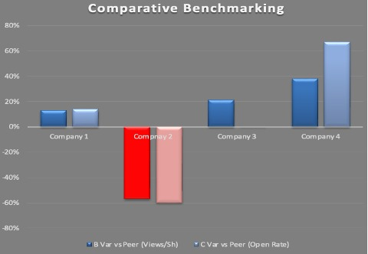
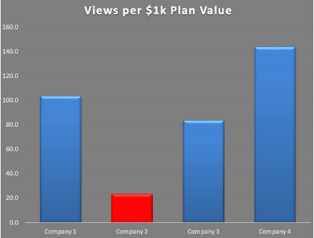
Two additional lenses are used:
Comparative Benchmarking (gap vs peer average) – Compared with each company to the peer average (excluding Company 2) to quantify under/over-performance. Variance % = (Company − Peer Avg) / Peer Avg
Engagement Efficiency (value per $ paid) - Measure platform usage relative to plan spend (ROI proxy). Views per $1k = Views / (Plan Value/1000)
Conclusion
Severe multi-channel gap: Company 2 is –57% vs peers on Views/Shareholder and –60% vs peers on Email Open Rate → materially below the “healthy” peer baseline.
Lowest value realization: Company 2 delivers only 23.3 views per $1k (peers: 83–144) → high risk as they don’t perceive ROI, weak value capture and low traffic.
Implication: Company 2 is the clearest churn-risk account and should be prioritized for a short engagement uplift plan.

Slide 4
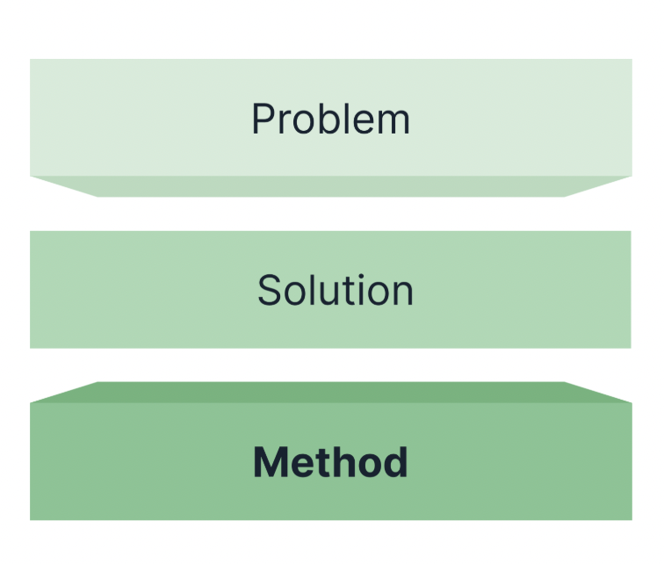
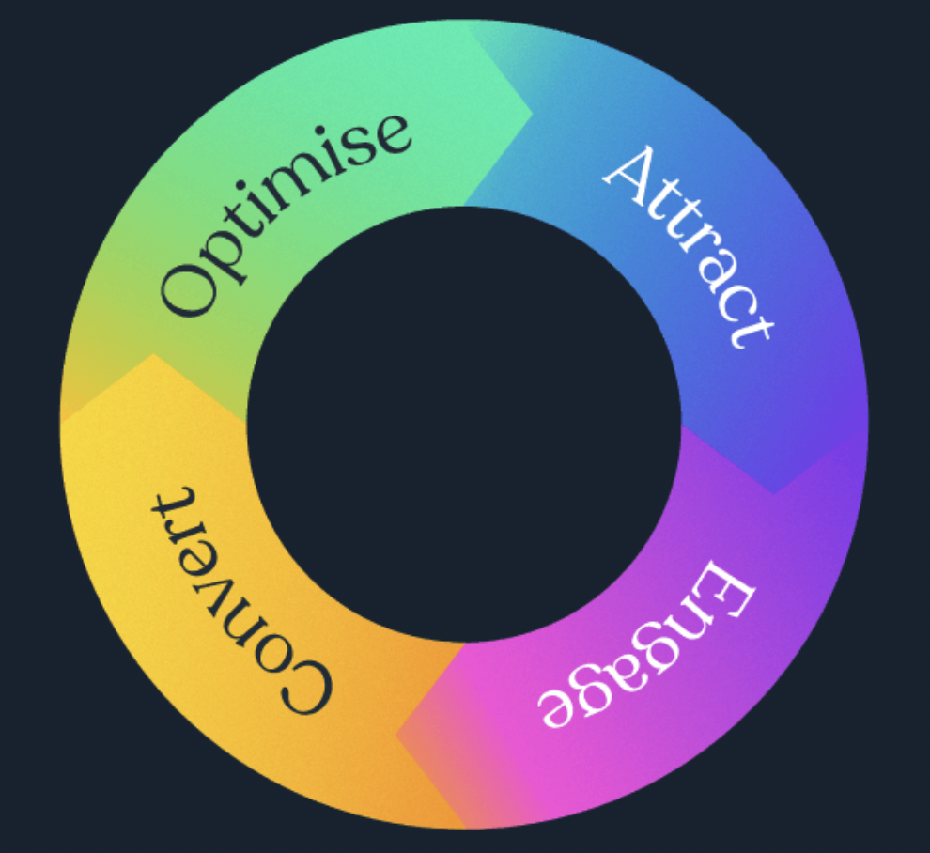

Actionable Insight (Sales/CS): Engagement Uplift Sprint Priority account: Company 2 (highest renewal risk).
Company 2’s engagement gap indicates low adoption and weak value realization, increasing renewal risk. InvestorHub’s Direct-to-Investor (D2I) methodology is built to overcome this.
Goal (14–21 days):
Lift usage across email and hub with measurable uplift and a repeatable playbook.
Sprint plan
Baseline and targets: Use current performance as the baseline and target uplift to 25–30% open rate and 0.30+ views/shareholder within 2–3 weeks.
Fix distribution: Use InvestorHub tracking and workflows so every update is delivered reliably.
Improve Content: : Rewrite Company 2’s next two announcements into short, narrative-led milestone posts with clear CTAs (“what changed / why it matters / what’s next”)
Activate and test :1 webinar/Q&A with rapid A/B tests (to test subject lines and send time to optimize emails)
Success metrics: Open rate, CTR, views/shareholder, repeat visits, webinar attendance/replay Expected outcome: Higher engagement with stronger perceived ROI and reduced churn risk

Slide 5
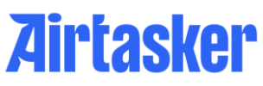
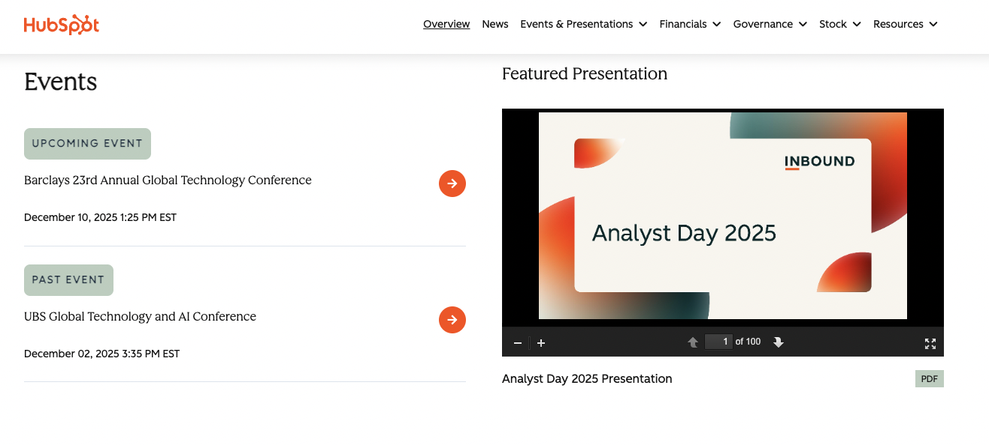
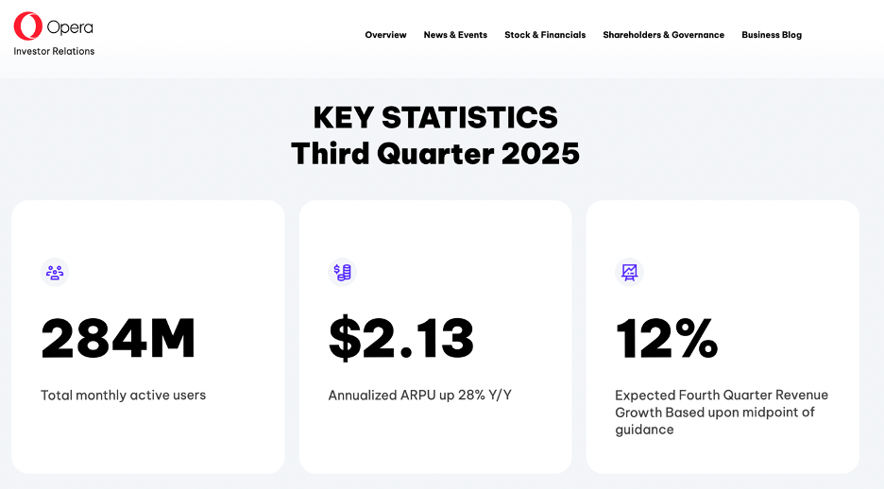
Airtasker Investor Hub: UX gaps
Recommendation 1 — Featured Presentation and Latest Results Pack above the fold
A homepage module that auto-surfaces Latest Results with 1-click buttons: Results Deck | Release | Webcast Transcript and Next key date. Investors land asking “what’s latest?” and this removes search time. Expected benefit: Higher engagement with results materials, lower bounce and more informed investors. Measure: CTR to results pack, deck downloads, webcast plays, time-to-first-click.
Activity 2
HubSpot IR — Featured Presentation module (latest results surfaced above the fold). On the Right, Opera IR — KPI stat cards (key metrics scannable immediately).

Slide 6
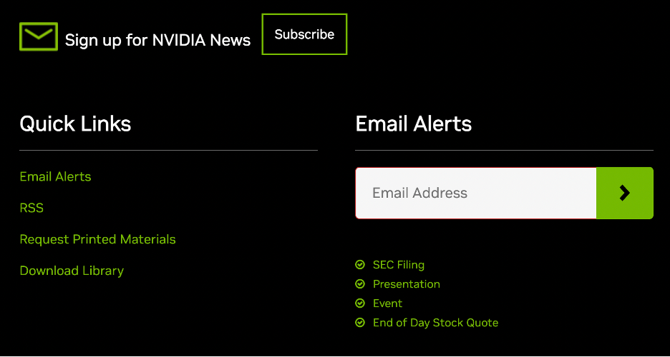
Recommendation 2 — Key Metrics Dashboard
A Key Metrics page showing 6–10 publicly reported KPIs with mini trends (6–8 periods) and definitions and links back to source announcements/decks. (As seen in Opera IR - previous slide) It Removes dependency on PDFs for basic understanding and supports quick comparison. Expected benefit: Higher time-on-site and repeat visits (becomes the reference page). Measure: views of KPI page, repeat visitors, scroll depth, clicks from KPIs → source docs.
Recommendation 3 - Proper Subscribe / Alerts and Calendar loop
Airtasker has Follow and footer Stay in the loop subscribe, but it’s not a primary action and doesn’t guide investors back at key moments. Thus, Promote Email Alerts: add a visible CTA on homepage and announcement pages and results pages. Upgrade to a Preference Center (tick-box alerts): ASX filings / Results / Presentations / Events / Share price updates.
Add Add-to-Calendar buttons on Reporting Calendar and webinar pages (Google/Outlook/ICS).
Expected Benefit - Higher repeat engagement + better event attendance/replay + stronger distribution reach.
NVIDIA IR — Email Alerts as a primary investor action (clear CTA and dedicated alerts section).

Slide 7
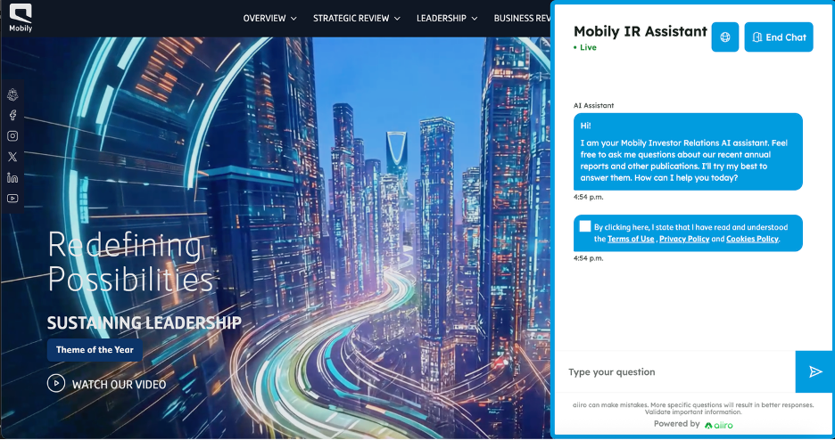

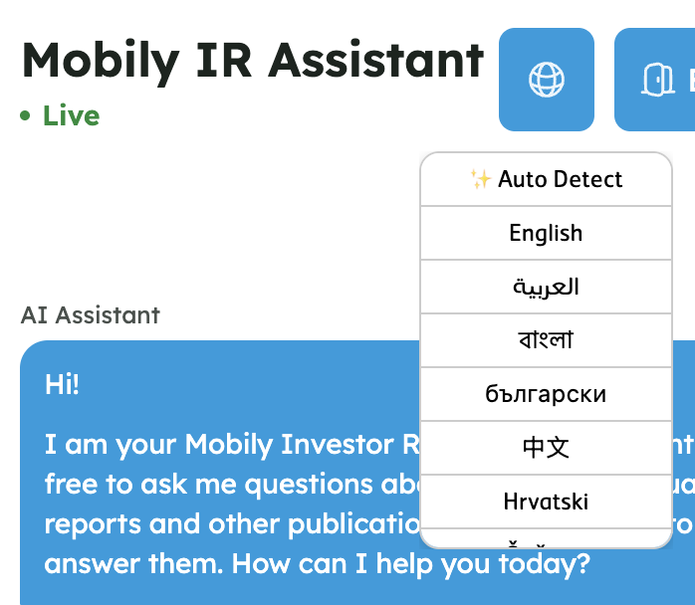

Recommendation 4 - Turn “Ask a question” into a searchable investor knowledge base (Q&A becomes an asset)
Airtasker now has Q&A on announcements, but answers aren’t reusable/searchable. Recommendation:
“Top questions this quarter” module
Searchable, human-reviewed Investor FAQ/KB
Related Q&As on results/announcement pages
IR-only AI assistant (answers only from approved IR content + cites sources) and supports multiple languages.
This ensures faster answers, fewer repeats and higher trust. Benefit: Less repetitive IR support and deeper engagement on results pages. Measure: FAQ searches, Q&A views, repeat-question drop, CTR to source docs, time-on-site.
Mobily IR — IR assistant pattern for fast investor Q&A and guided discovery of investor materials with multilingual support

Slide 8
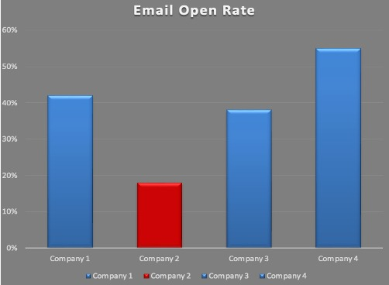
REFERENCES
Company | Views/Shareholder | Peer Avg Views/Shareholder | Var vs Peer (Views/Sh) | Email Open Rate | Peer Avg Open Rate | Var vs Peer (Open)
ALP Limited | 0.44 | 0.39 | 13% | 42% | 37% | 14%
Company 2 Group | 0.2 | 0.47 | -57% | 18% | 45% | -60%
DLT Mining | 0.46 | 0.38 | 21% | 38% | 38% | 0%
GMX Tech | 0.51 | 0.37 | 38% | 55% | 33% | 67%
Internal analysis table (Activity 1): Normalized engagement metrics and peer-average benchmarking and variance calculations.
The graph here shows the email open rate.
External reference examples (Activity 2):
1. HubSpot Investor Relations — “Featured Presentation” / results surfaced above the fold 2. Opera Investor Relations — “Key Statistics” KPI cards (scannable metrics layout) 3. NVIDIA Investor Relations — “Email Alerts” signup + preference-style alerts 4. Mobily Investor Assistant — IR chatbot example (IR support pattern + multilingual)
Activity 1 – Excel working

Slide 9
Thank you for your time!
Happy to answer any questions.
✉️ s4149056@student.rmit.edu.au
🔗https://www.linkedin.com/in/sruthi-rajesh-3a587b200/

